Slide 1
MOVIE TICKET BOOKING SYSTEM
RA1911003010220 – Shresth Kapoor
RA1911003010219 – Aditi Rastogi

Slide 2
Objective
Project within Scope
Tech Stack
Tech Environment
Features
Project Preview
Code Previews

Slide 3
OBJECTIVE
The main objective of the Movie Ticket Booking System is to manage the details of seats, booking, customer details, shows. The project is totally built at user end and thus only the administrator is guaranteed the access. The purpose of the project is to build an application program to reduce the work and time needed to go and book the tickets. It tracks all details about the same.

Slide 4
PROJECT SCOPE
All types of users can book the tickets.
Globally accessible.
24 hours accessible.
User friendly.
Secure

Slide 5
TECH STACK
Tech Stack used –
Python
SQLite 3
Python modules used –
Tkinter
Turtle

Slide 6
ENVIRONMENT:
Jupyter Notebook
Colab
VS Code

Slide 7
FEATURES:
ADD NEW
This feature enables the users to boo tickets for more than one movie at a time.
2. DISPLAY
This feature displays history of all the tickets booked by the user so far.
3. CLEAR
To clear the entries given by the users.
4. EXIT
To exit the application

Slide 8
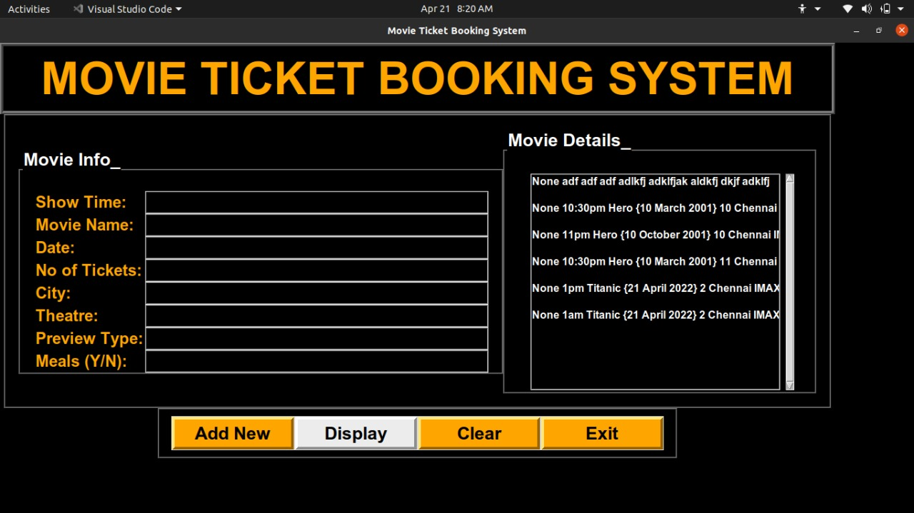
PROJECT PREVIEW

Slide 9
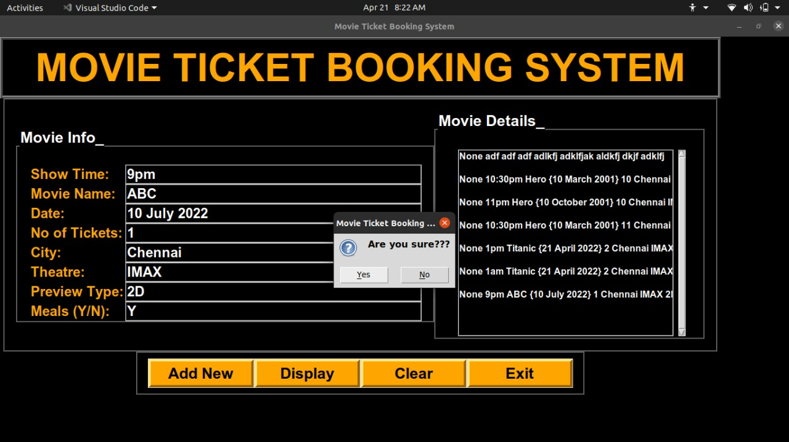
PROJECT PREVIEW

Slide 10
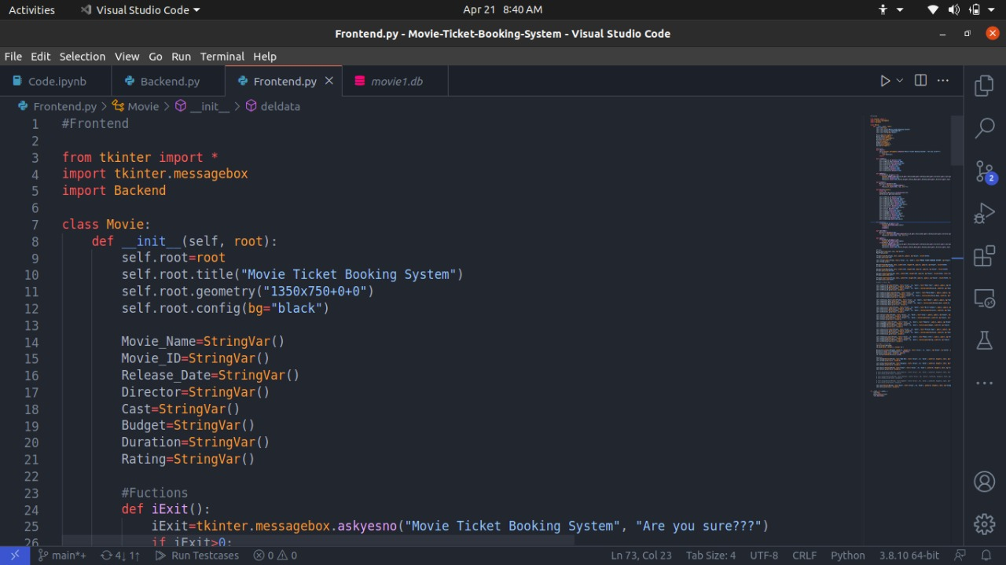
CODE PREVIEWS
Frontend

Slide 11
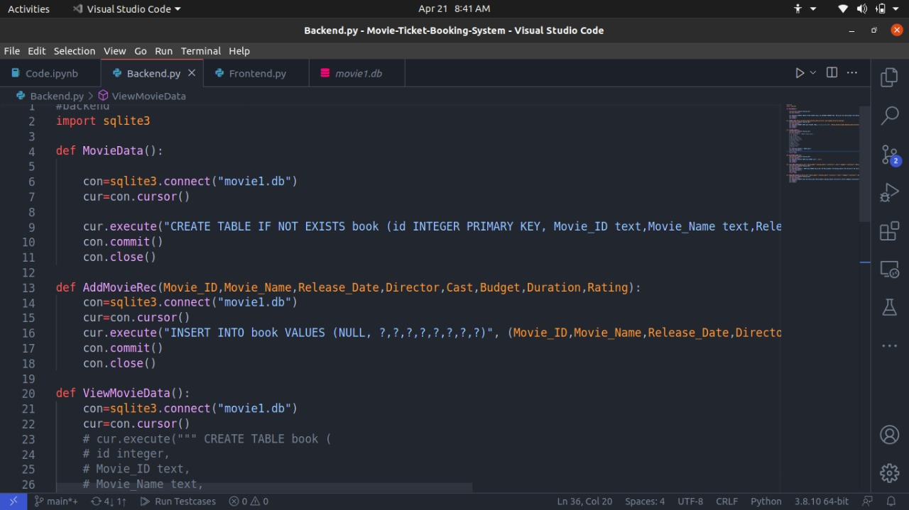
CODE PREVIEWS
Backend

Slide 12
PROJECT LINK–
https://github.com/AditiRastogi250701/Movie-Ticket-Booking-System

Slide 13
THANK YOU

